Slide 1
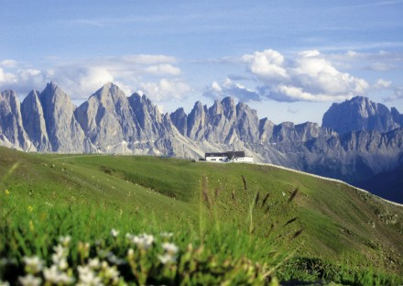
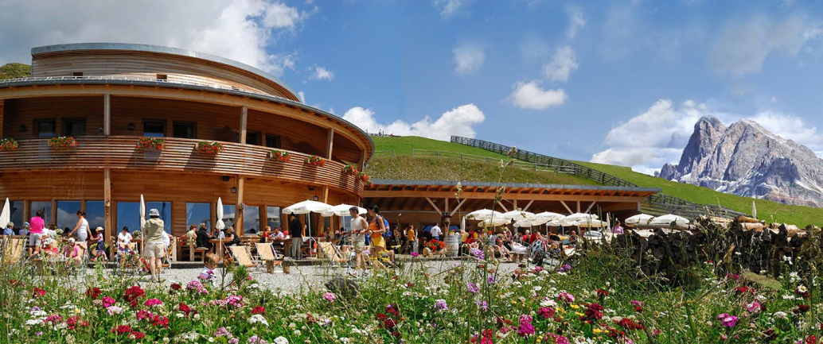
CSAMA Social Programme
Wednesday 2022-06-22
Mount Plose
RossAlm Hut

Slide 2
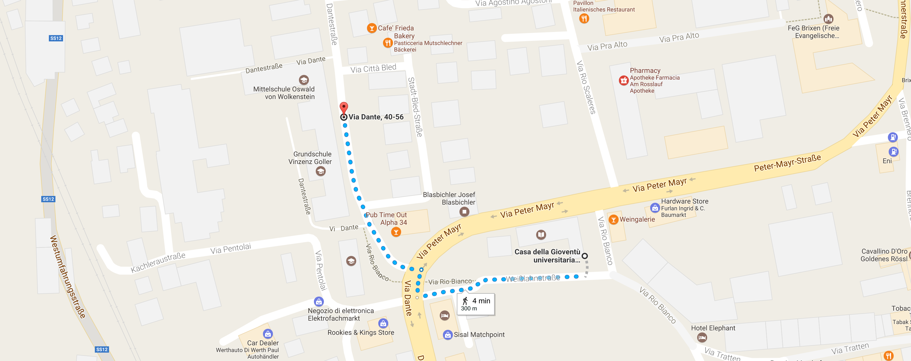
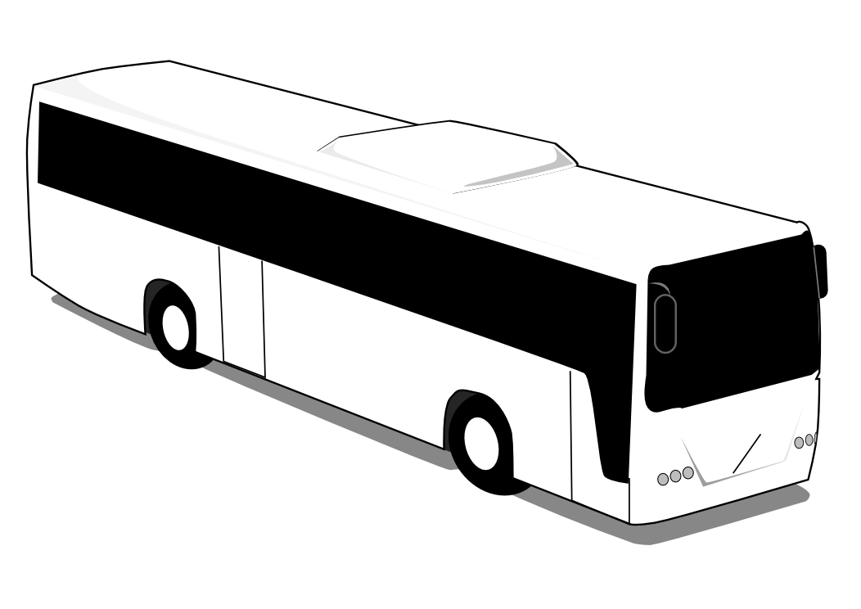
CSAMA Social Programme – Timeline
2:00 pm We meet at “Casa della Gioventù” and walk 1 min to the bus waiting for us in Via Dante.
Please take the underpass to cross “Via Peter Mayr.”

Slide 3
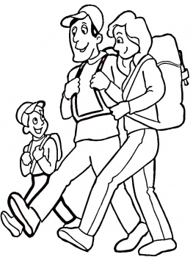
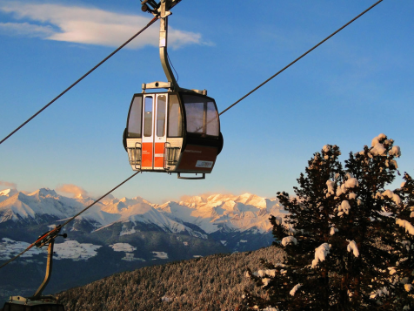
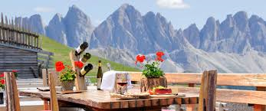
CSAMA Social Programme – Timeline
2:15 pm The bus leaves towards the cable car for Mount Plose.
2:45 pm The cable car takes us to the top of Mount Plose in about 20-30 min.
45-60 min Hiking to RossAlm at 2200 m altitude.
6:00 pm Dinner at RossAlm.
8:00 pm Time to leave! We walk back to the bus from RossAlm.
9:00 pm The bus takes us back to Brixen.

Slide 4
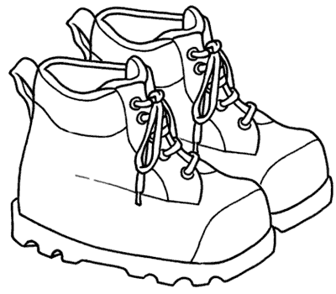
Please pack/bring:
Solid footwear (ideal: hiking shoes or boots)
Jacket or warm sweater for the descent (it may get quite fresh)
Please note: If you will not attend the social programme, please let us know at the latest on Monday 20th June via email to info@bioconductor.eu

Slide 5
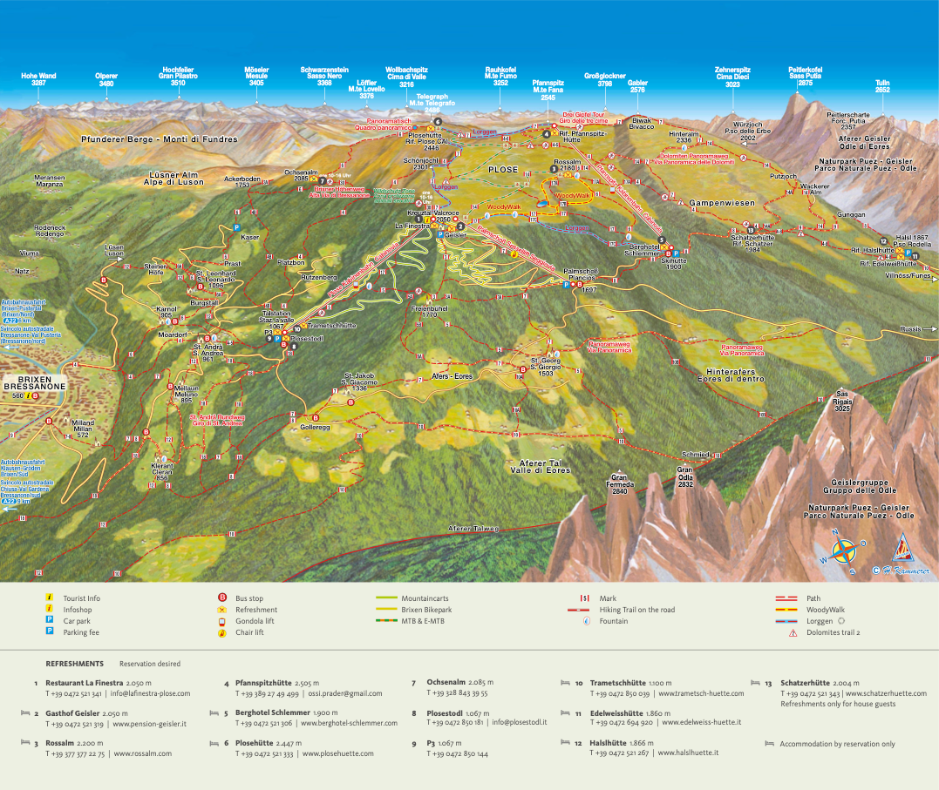

Slide 6
https://wetter.provinz.bz.it/niederschlagsvorhersage.asp

